Slide 1
SQUAD CAL SMARTHACK
Win or lose, give it your all

Slide 2
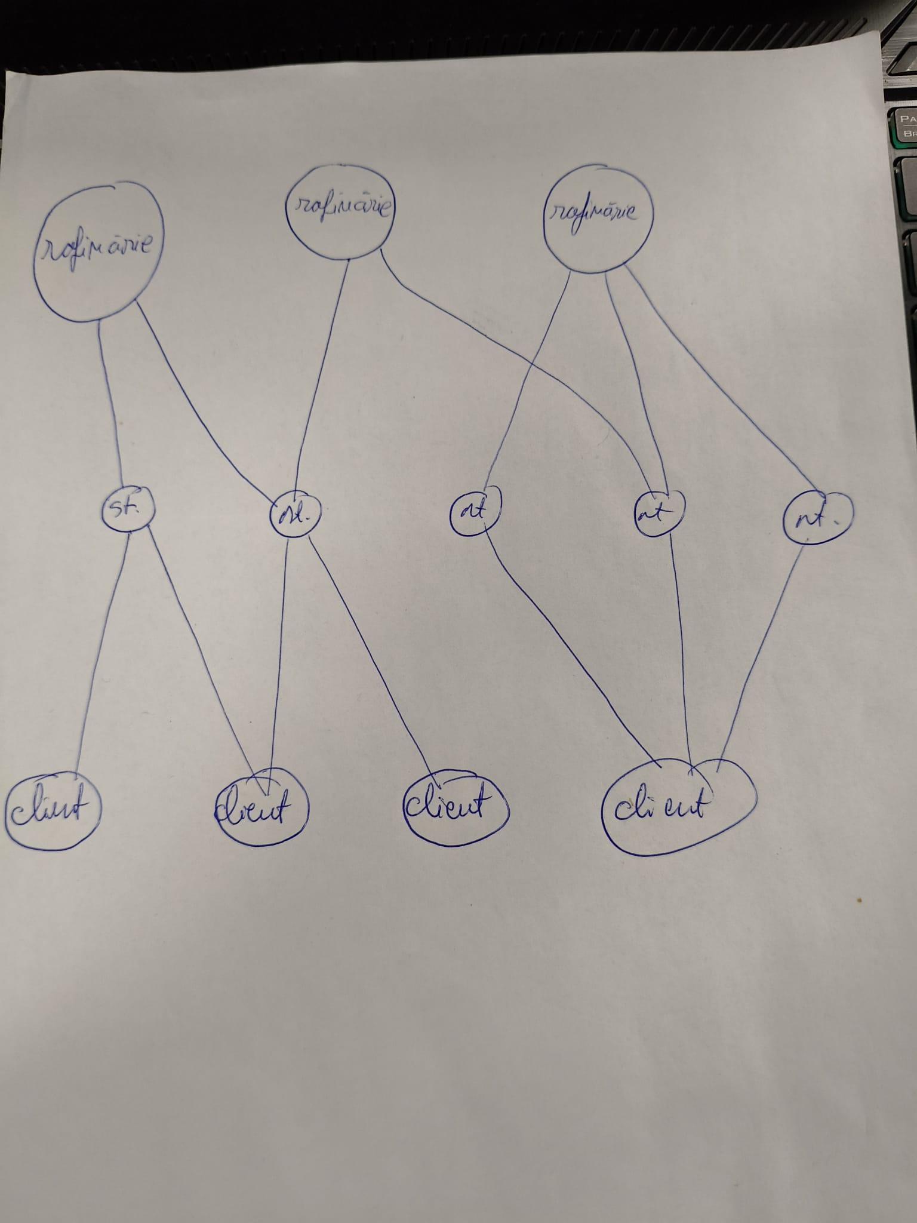
FUNNY FIRST ALGORITHM IDEA

Slide 3
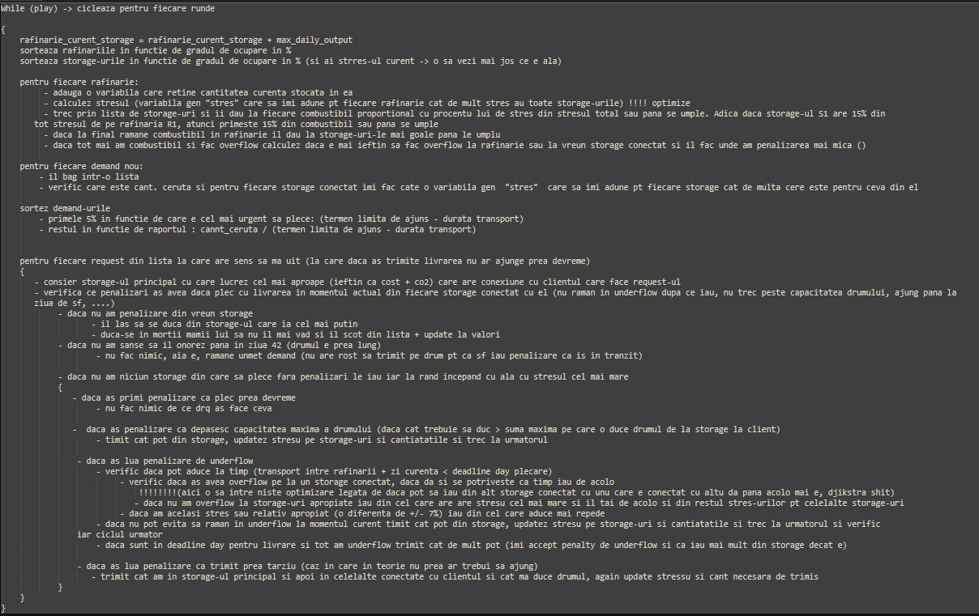
FUNNY FIRST ALGORITHM IDEA

Slide 4
ALGORITHM “LAST RESORT”
“AM N-AM MINGEA DAU LA POARTA”
+
“CLIENTU NOSTRU STAPANUL NOSTRU”
=
LAST RESORT ALGORITHM

Slide 5
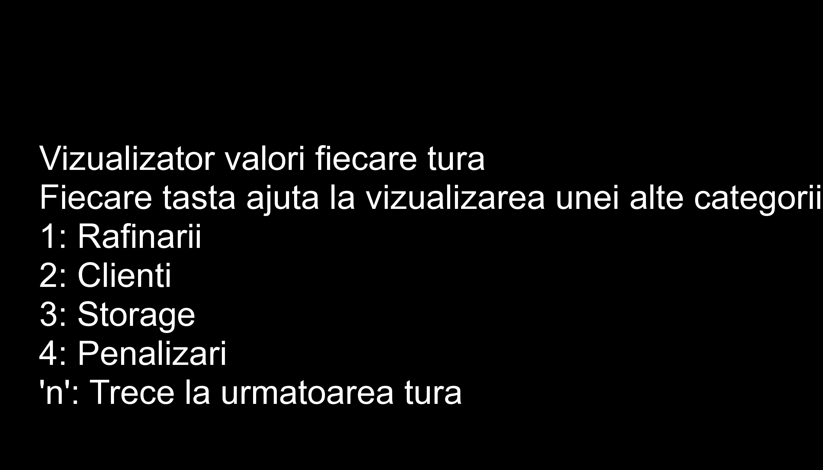
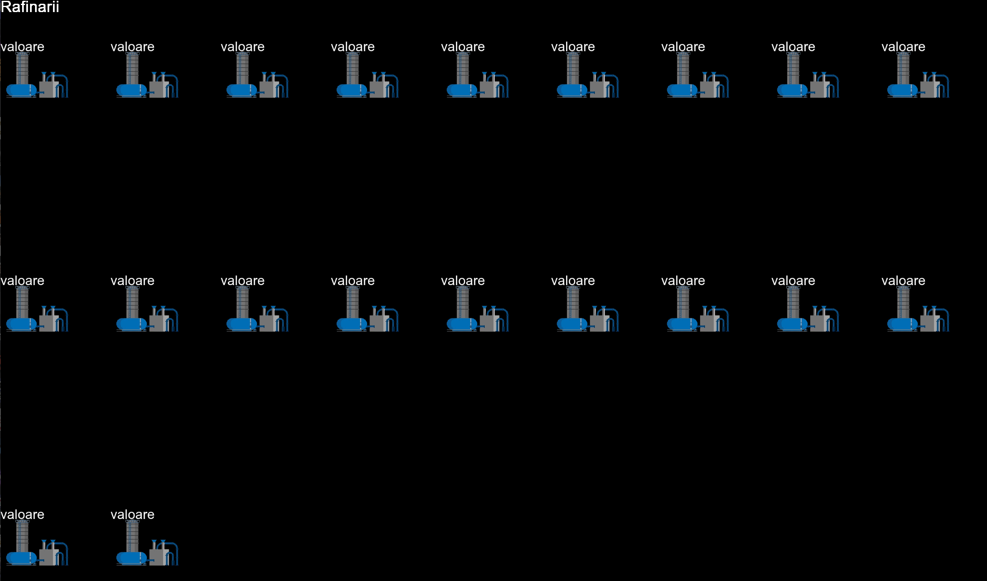

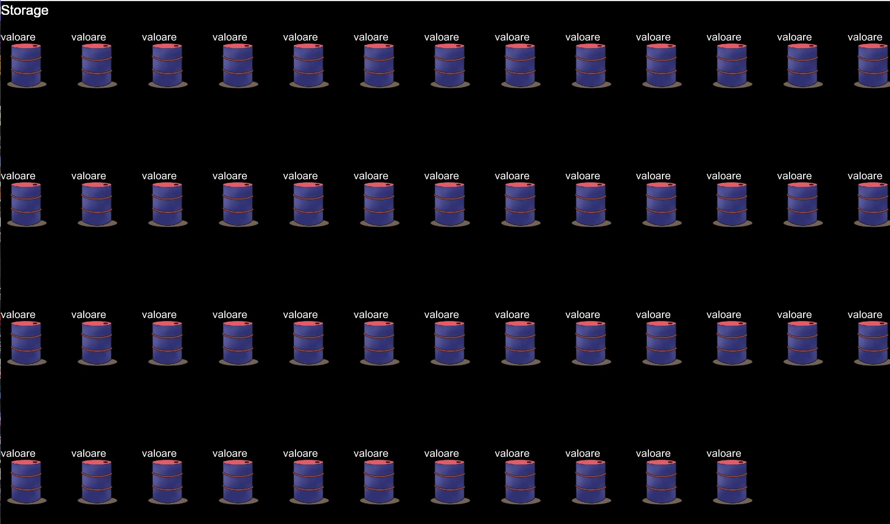
UI

Slide 6
CONCLUSIONS
Things to improve
Communication between the participants
Lear more oop
Less sugar
Not sleep ☺

